Slide 1
Inductor Core Comparison
Furkan Tokgöz

Slide 2
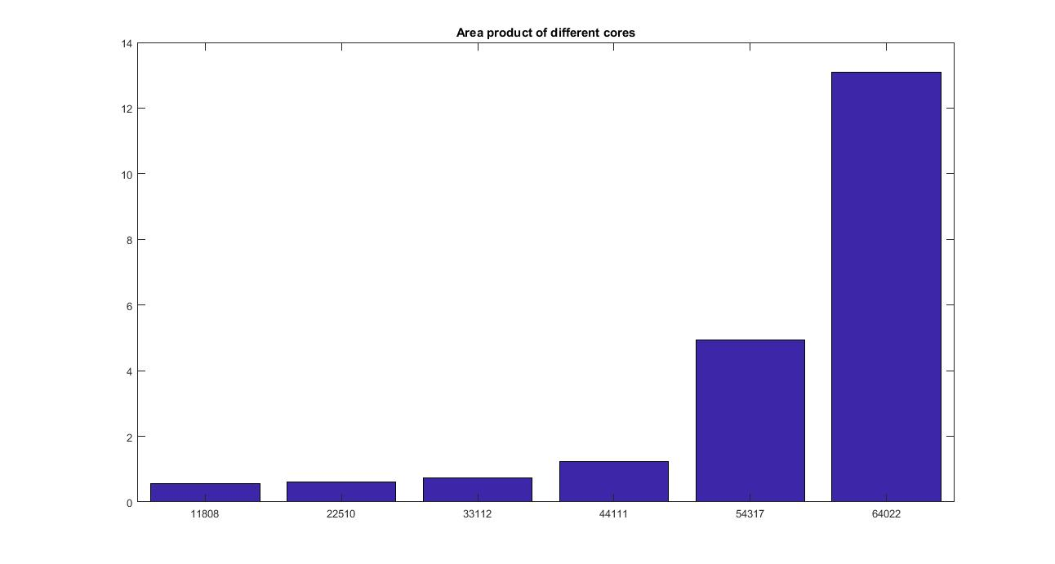
Area Products

Slide 3
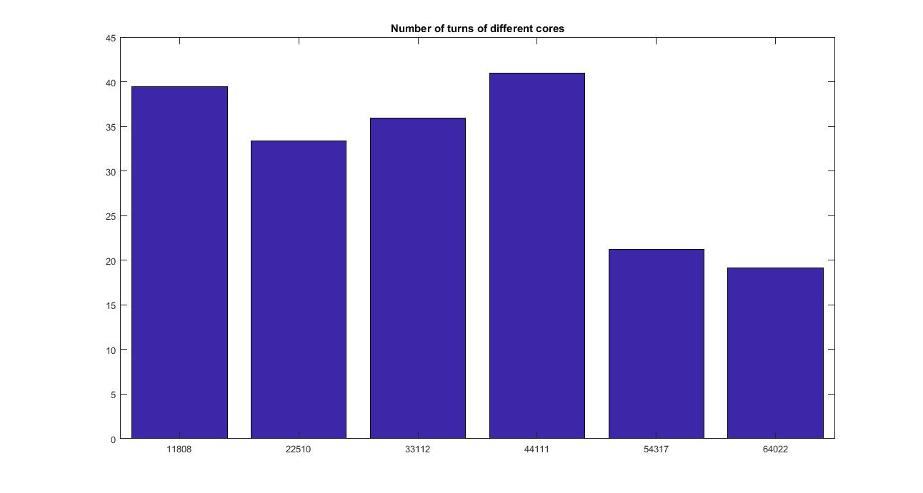
Number of Turns

Slide 4
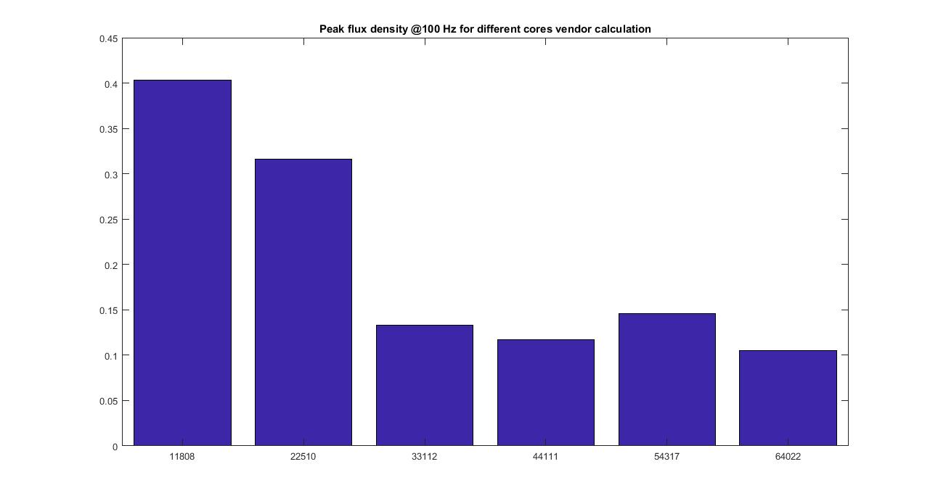
Peak Flux Density

Slide 5
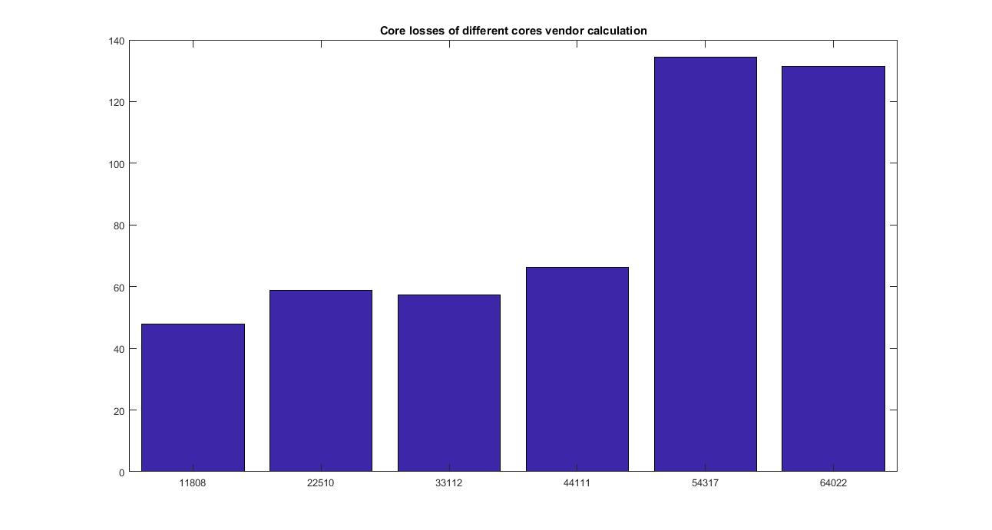
Core Loss

Slide 6
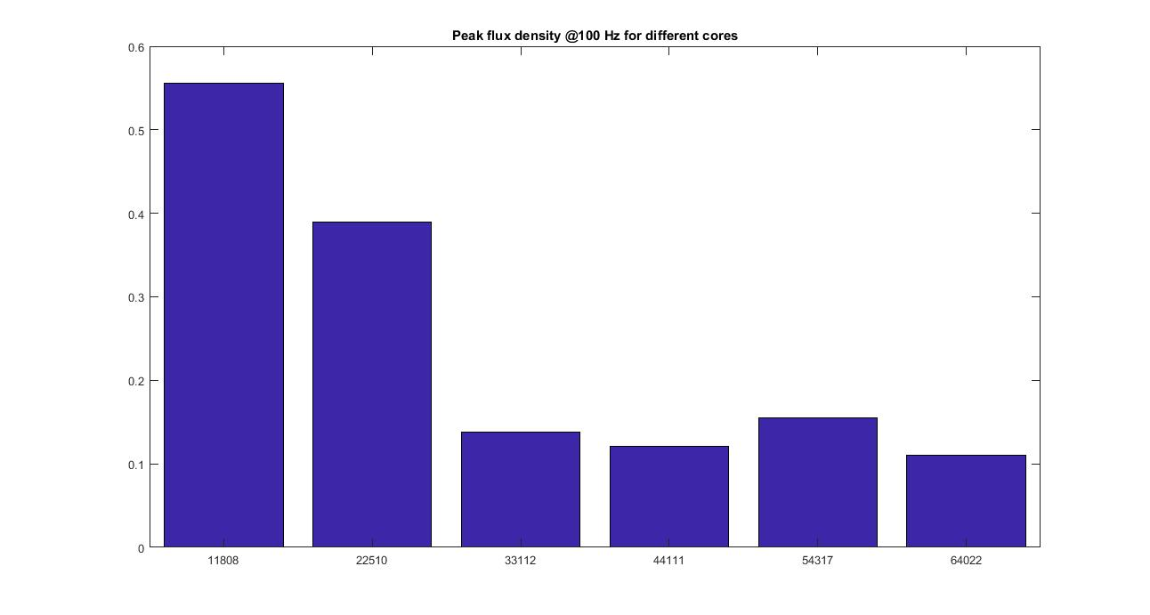
Peak Flux Density

Slide 7
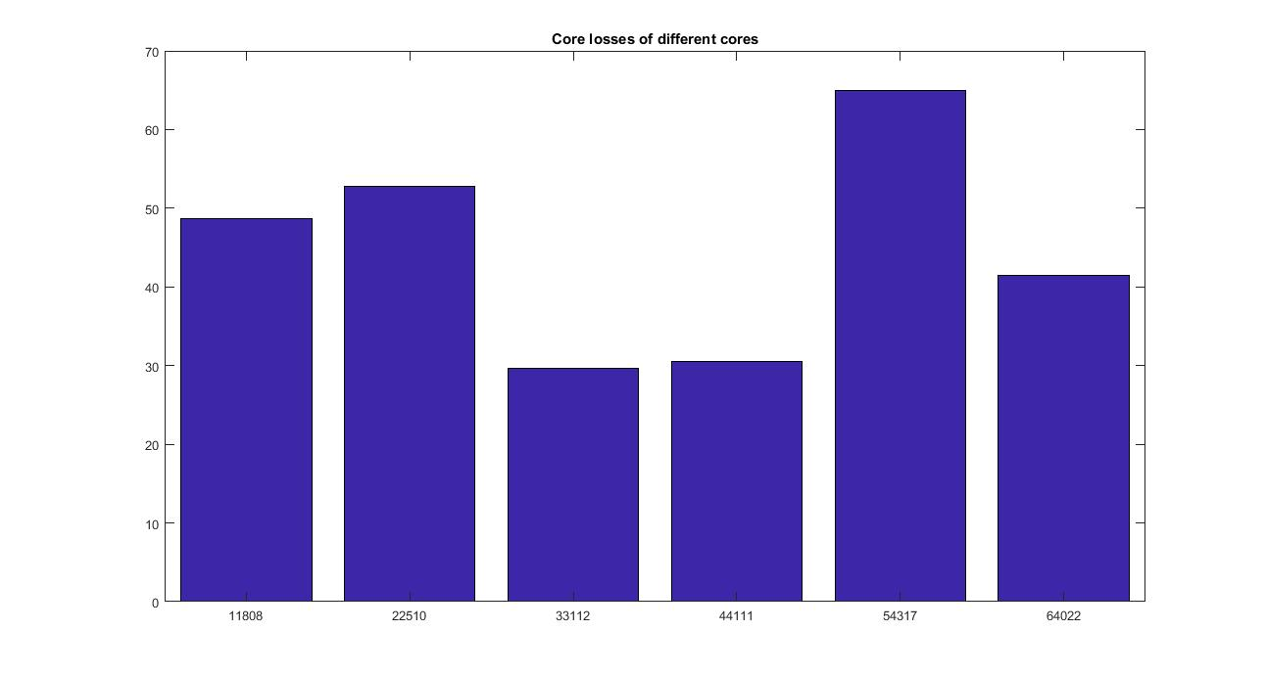
Core loss

